Slide 1
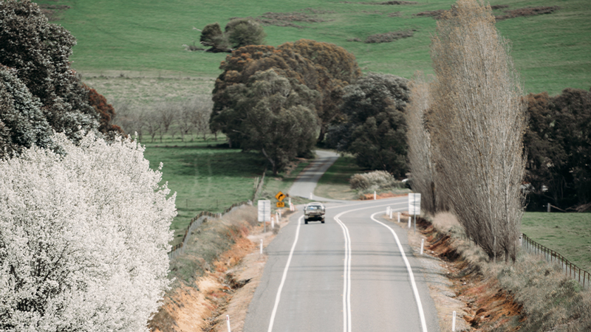



Upper Lachlan Shire Council Community Outreach Meeting
Bigga
28 October 2025

Slide 2
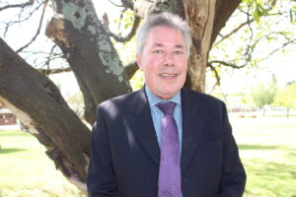
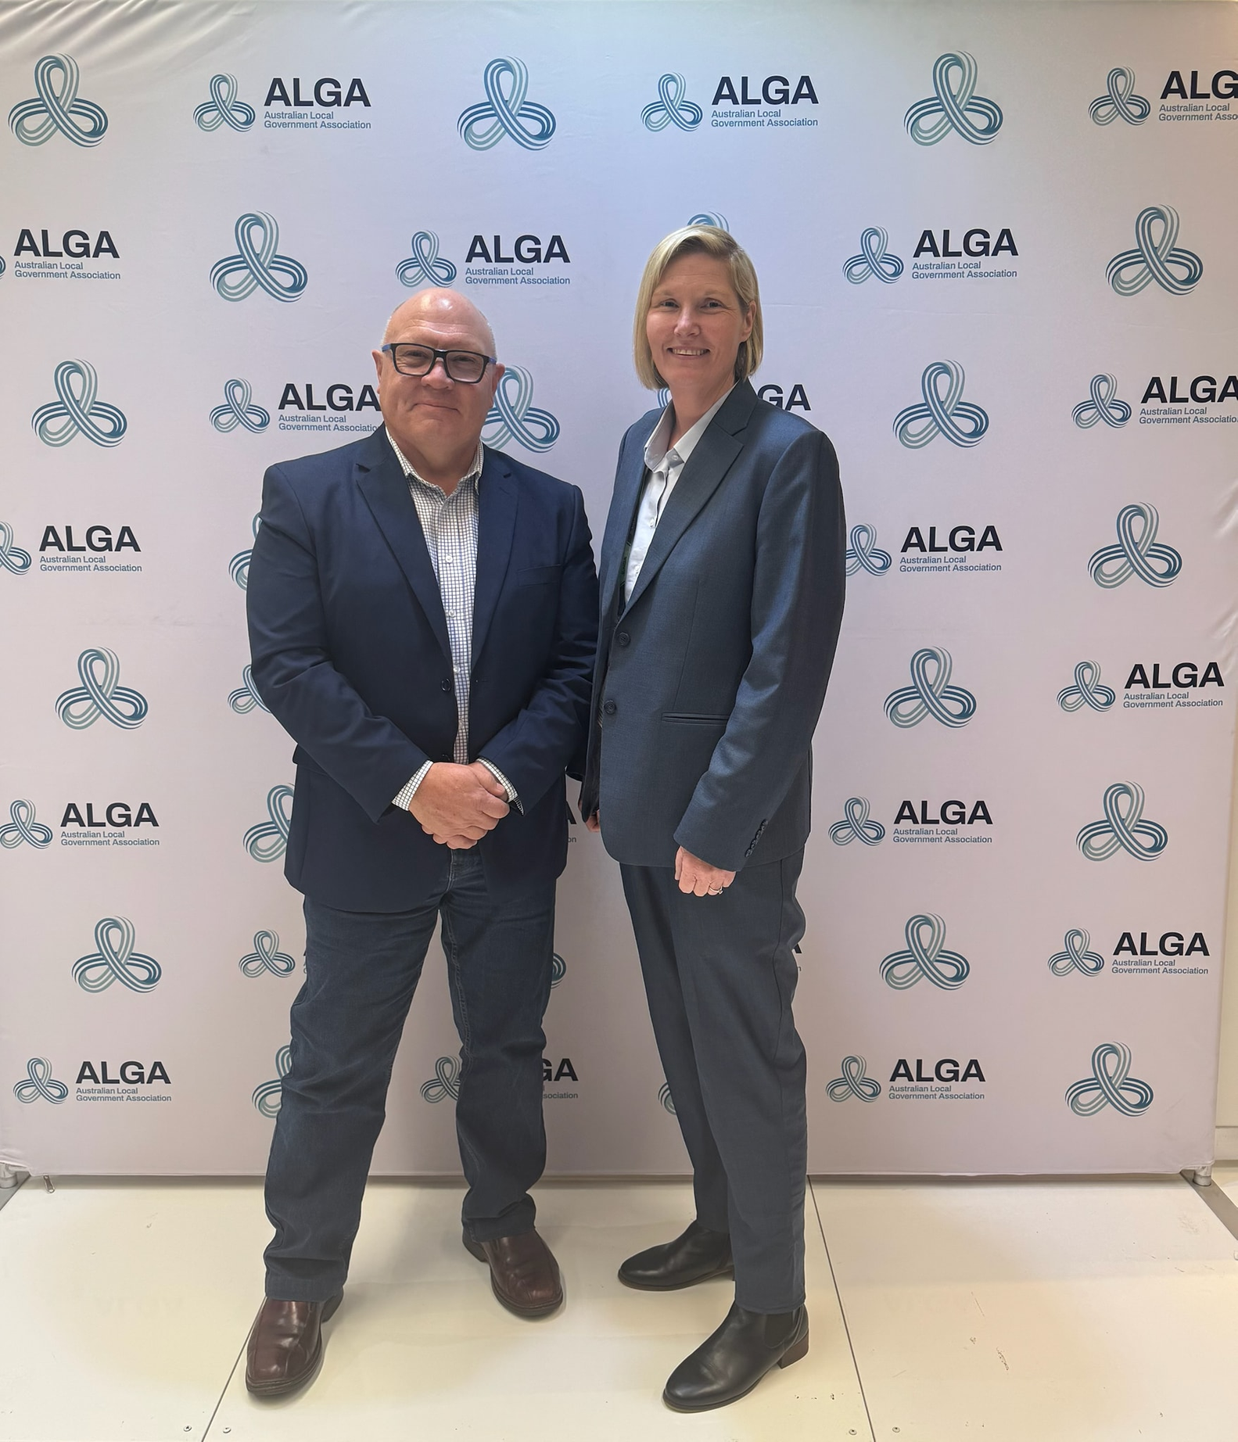
Mayor and CEO
Introduction and Greetings
Paul Culhane
Mayor
Alex Waldron
Chief Executive Officer
Apology

Slide 3
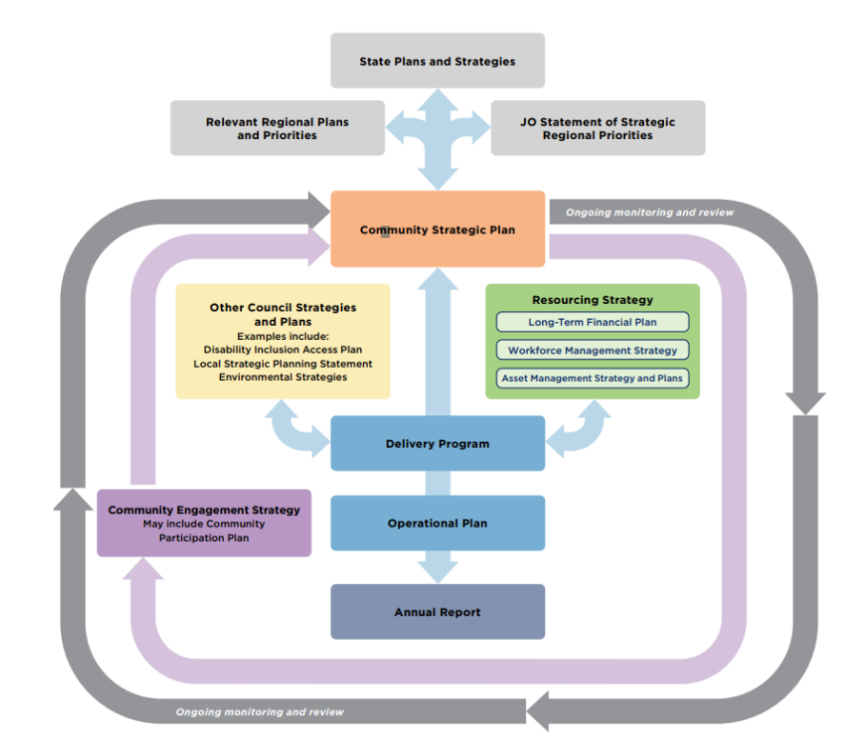

Slide 4
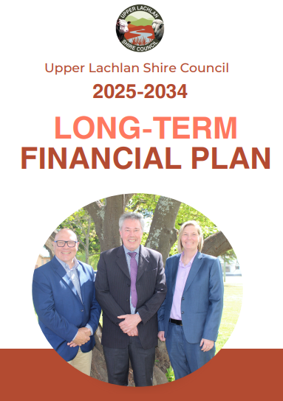




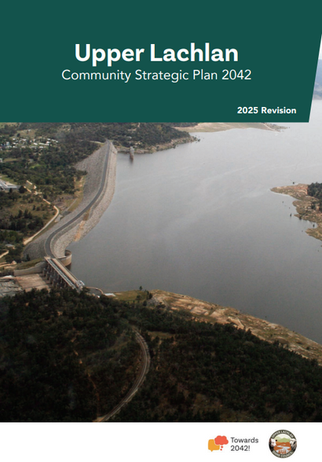

ULSC - Strategic Documents

Slide 5


Financial Performance Indicators
Performance Measures | 2022/2023 | 2023/2024 | 2024/2025
Unrestricted Current Ratio
Own Source Operating Revenue Ratio
Rates and Annual Charges Outstanding
Debt Service Cover Ratio
Building and Infrastructure Renewals Ratio
Operating Performance Ratio

Slide 6
Cash Flow Position
Actions taken to address the long-term financial sustainability of Council.
Cash position has improved at 30 June 2025. Council unrestricted cash position has improved from 117K (2023) to $1.524 million (2025).
Asset sales proceeds have been used to replenish internal restricted reserve funds such as the buildings and infrastructure reserve and plant replacement reserve. These sales were not used to artificially increase the unrestricted cash reserves.
Council has taken measures to increase discretionary cash position including service level decisions taken by Council, management undertaking business unit service reviews and an organisation restructure with reduction in workforce numbers in 2024.
Annual budget savings achieved of over $1.5 million as a result of measures taken by Council.

Slide 7

Operational Plan 2025/2026
  Council operational budget for 2025/2026 is $43 million.
  Operational Plan is a public document on Council website reviewed and updated each financial year.

Slide 8

Upper Lachlan Shire - Ordinary Rates Income
  Council ordinary rates total income is $9.65 million (per annum). This equates to 23% of all income sources in the operating budget.
(Note: information above excludes annual charges for water, DWM & sewer)
  Farmland rating category accounts for 64% of total ordinary rates income.
  Residential rating categories accounts for 28% of total ordinary rates income.

Slide 9
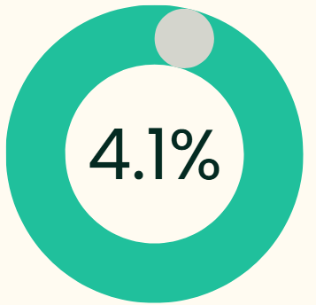
Bigga Ordinary Rates Income
Bigga locality (includes surrounding parishes) has 345 rates assessments with ordinary rates income totalling $402,996 (per annum).
This is 4.15% of the total ordinary rates of the Upper Lachlan Shire

Slide 10

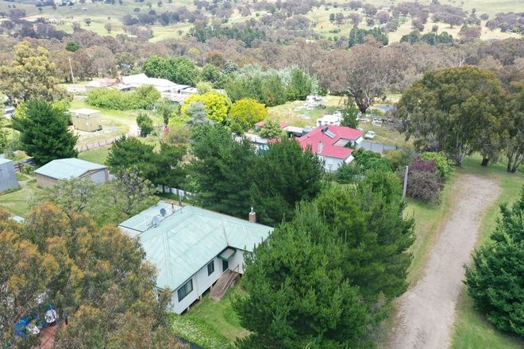
Council services provided to Bigga Region
  Roads/Bridges/Footpath
  DWM Waste Collection
  Waste Transfer Station
  Hall and Toilet Amenities
  Sporting Field/Camping Ground
  Playground, Parks and Gardens
  Cemetery management
  Ranger / Animal Control
  Biosecurity and Noxious Weeds Control
bigga

Slide 11
Bigga Projects Past 3 Years
CAPITAL WORKS PROJECTS (EXCLUDES MAINTENANCE/OPERATIONS)
These are projects completed in Bigga district from 2023 - 2025
$649,000
$346,000
Roving Art Show
CONTINUATION OF GRABINE ROAD
Bitumen sealing project- Sandy Creek causeway
FIXING LOCAL ROAD ROUND 3
Gravel resheeting-Mulgowrie Road
$428,000
LRCI ROUND 3; BOILER HILL SECTION
Reids Flat Road Upgrade
$85,000
$1,318,000
ROADS TO RECOVERY-GRABINE ROAD 2024
Gravel re-sheeting
FIXING LOCAL ROAD ROUND 2 Road reseal program; Bigga Road
Approx $14 Million Shire wide – over 4 year period
Natural Disaster road restoration works across localities in the Shire

Slide 12
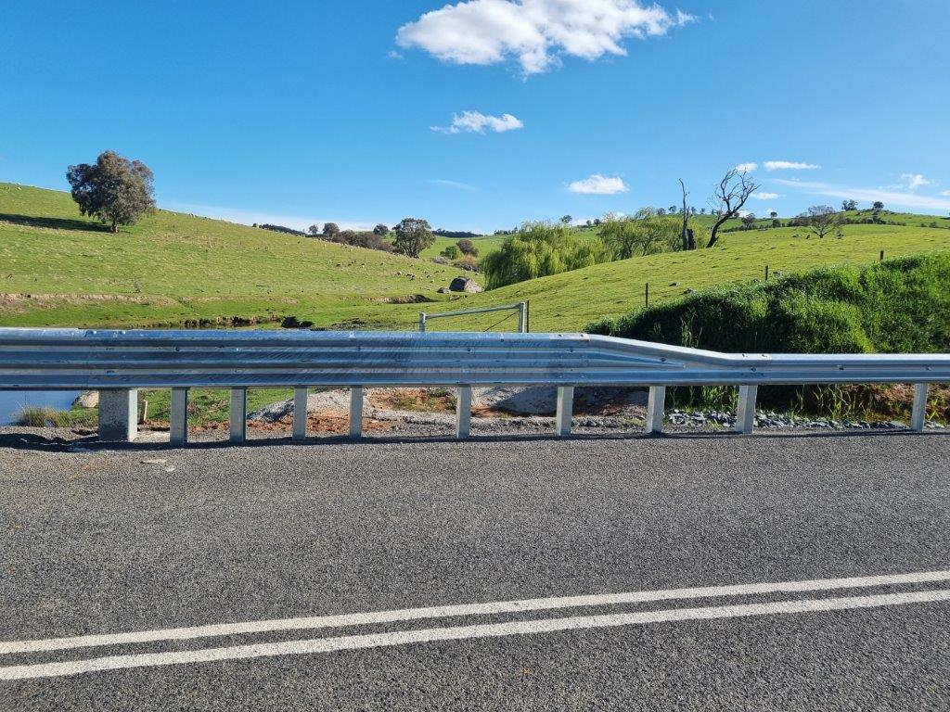
Bigga – Grabine Road

Slide 13
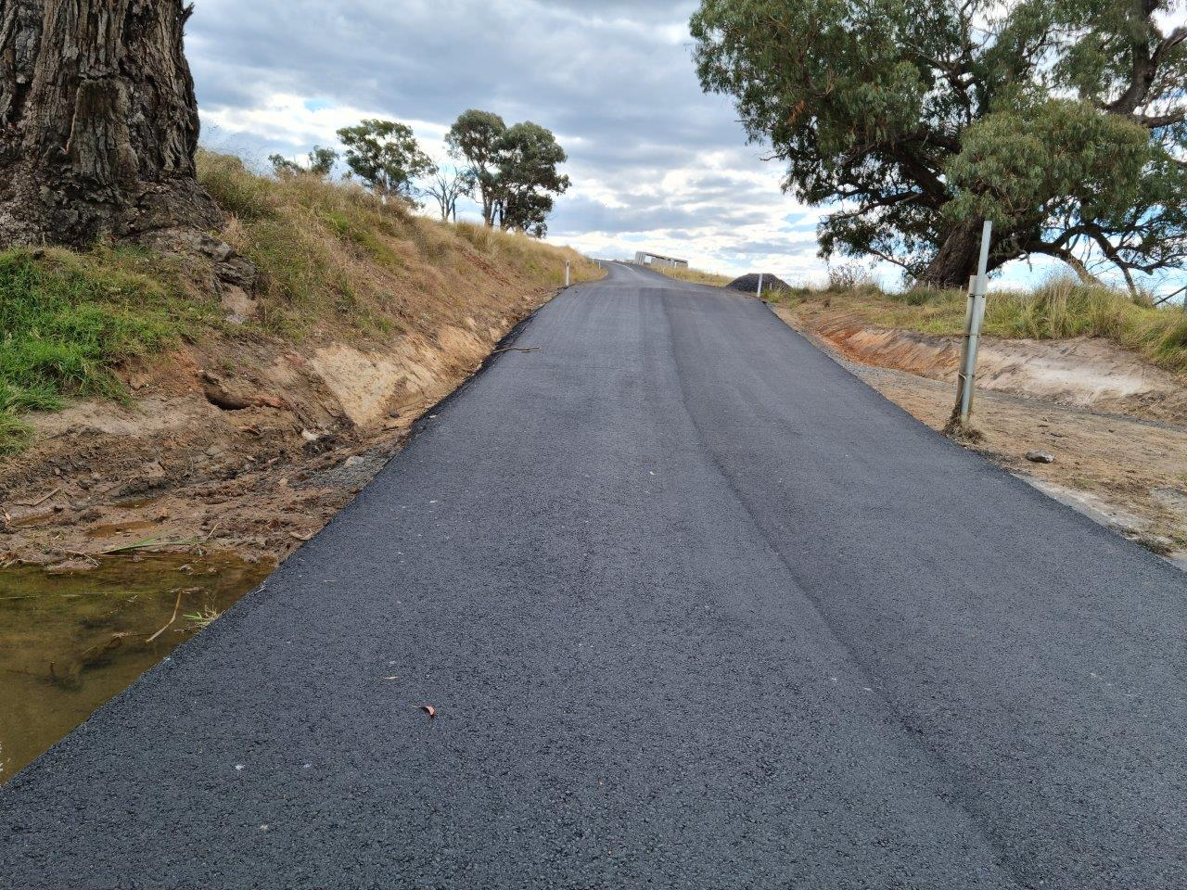
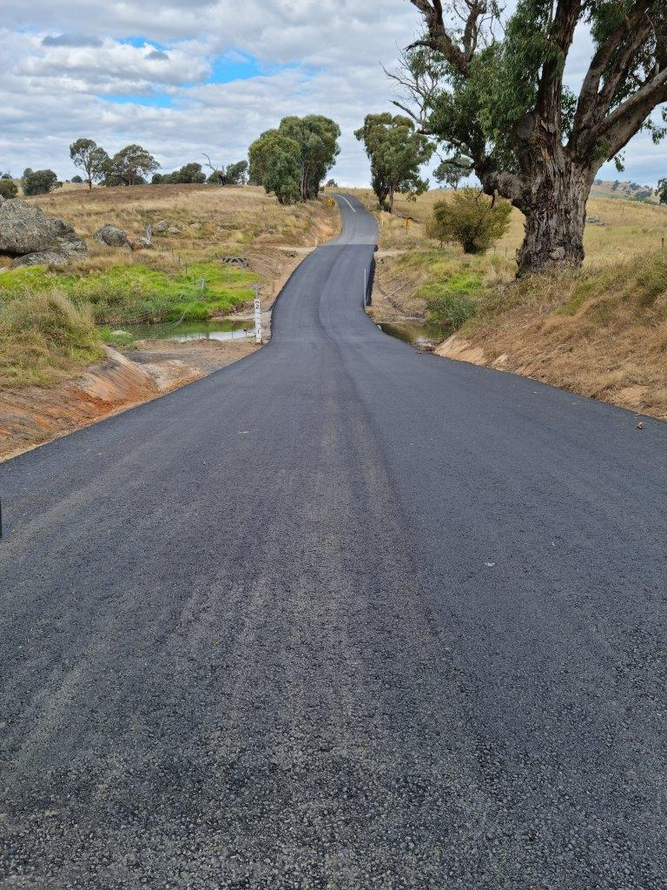
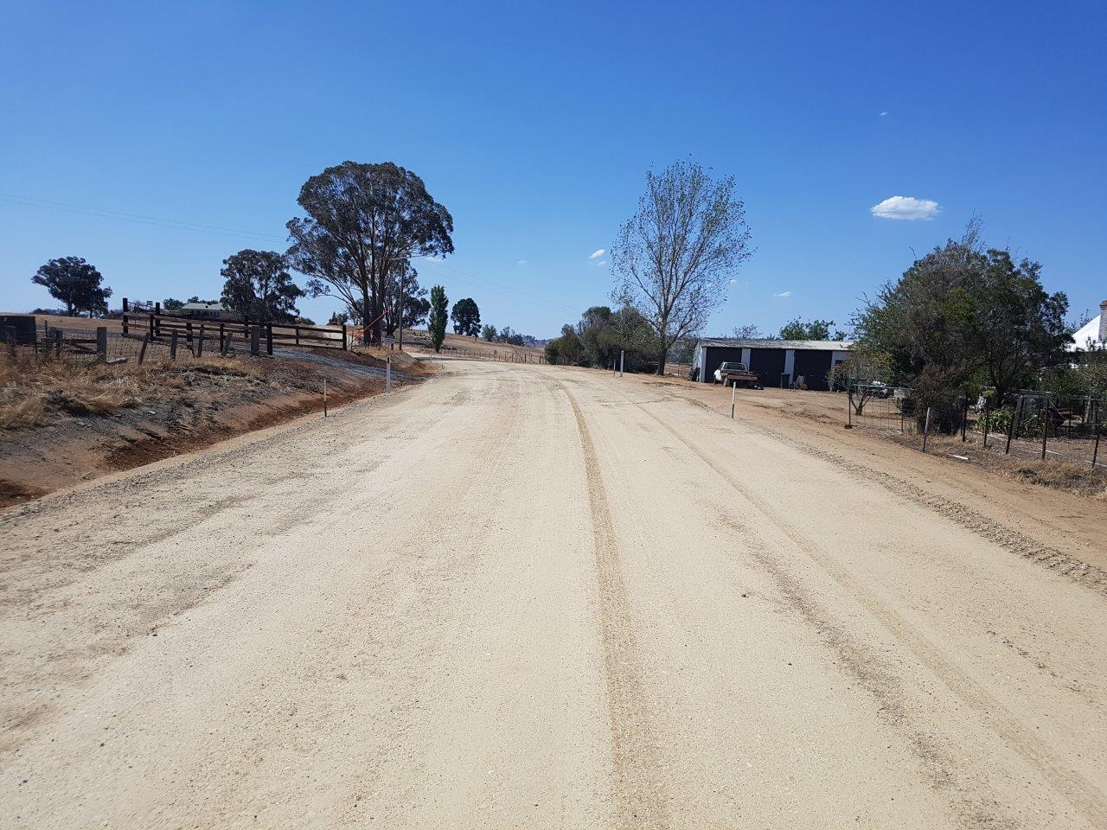
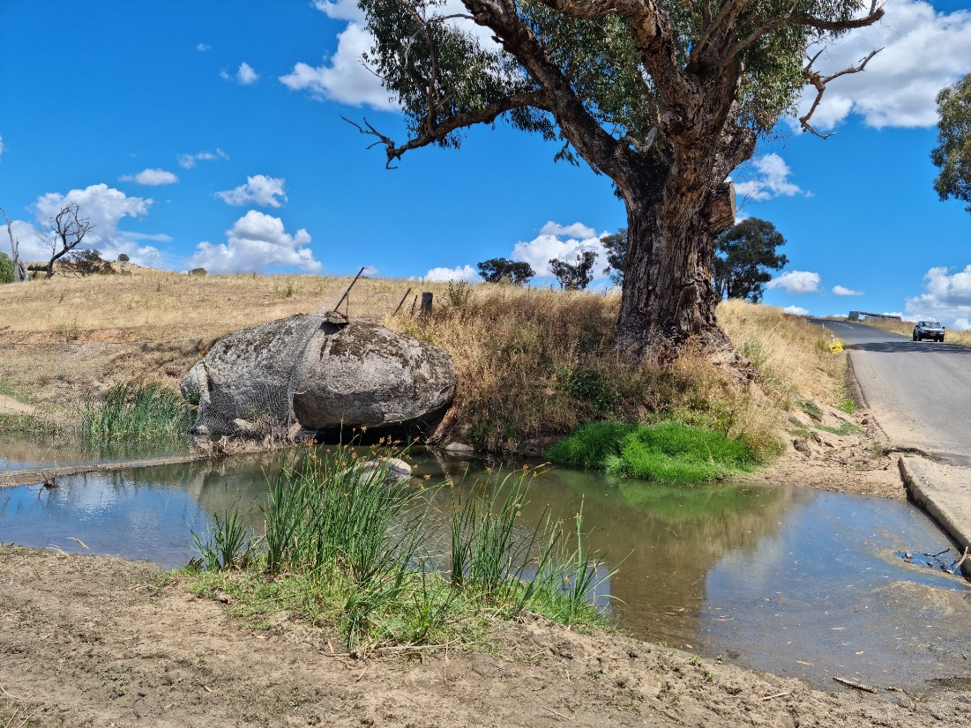
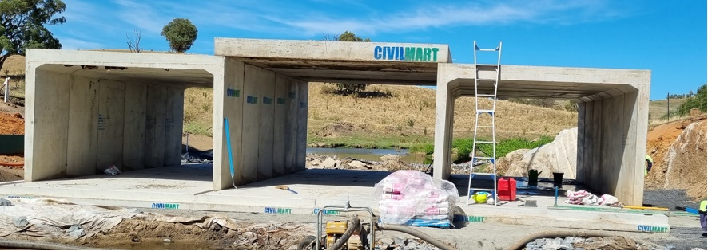
Bigga – Grabine Road
$3,987,673
Grabine Road Reconstruction project has included
6km unsealed to seal then a further 4.5km gravel re- sheet
Road widening
Drainage works
Pavement unsealed to seal
Line marking & signage
Replacement of existing causeway on Sandy Creek to large box culverts (construction photos attached)
Guardrails

Slide 14
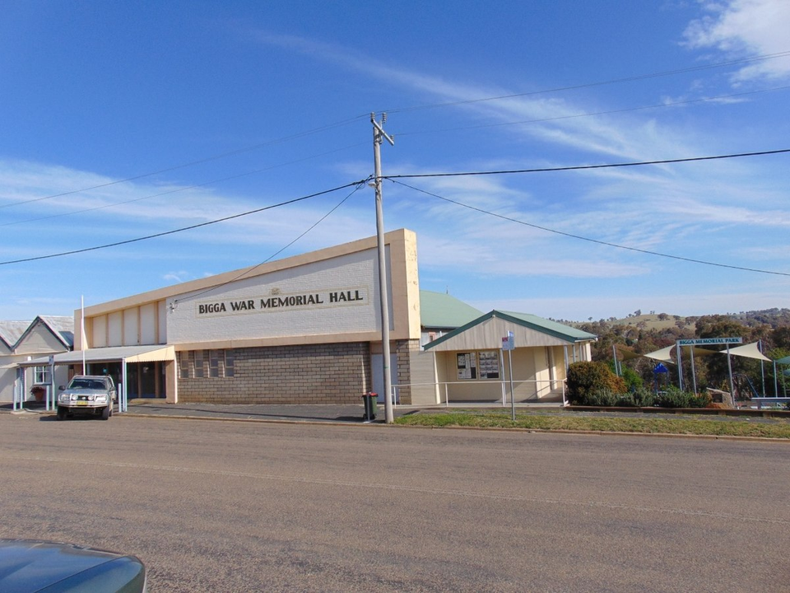
Bigga Forward Works Plan
CAPITAL WORKS PROJECTS (EXCLUDES MAINTENANCE/OPERATIONS)
$173,000
$160,000
Roads to Recovery – Grabine Road - Gravel resheeting-Grabine Road
Marks Street – Bigga
Cemetery Road
Sealing of the existing unsealed road (0.650Km)
$200,000
Resurfacing Works (2km), Bigga Road - 2026

Slide 15
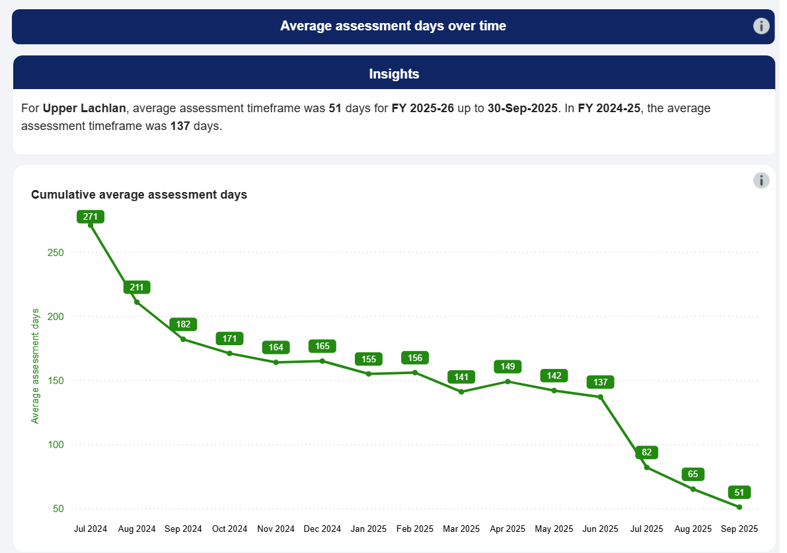
Development Applications – Timeframes

Slide 16
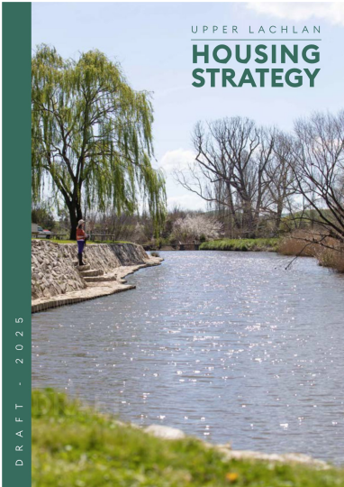

Housing Strategy & Development Control Plan

Slide 17
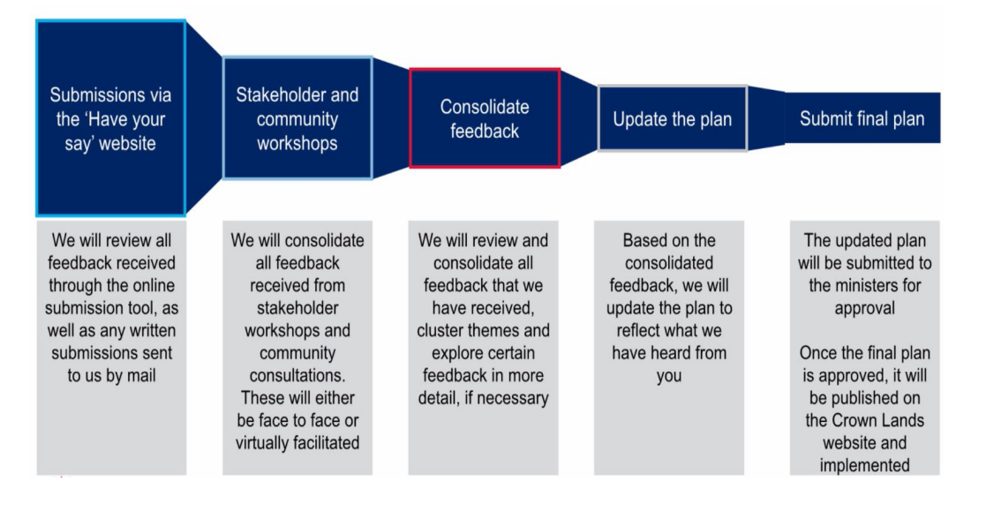
Early Engagement - Plans of Management

Slide 18
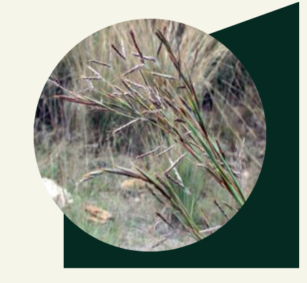
Noxious Weeds - Inspections
GOAL 1
GOAL 2
Mexican Feather grass & Parthenium Grass
Gorse, Sticky Night shade & Coolatai Grass
Inspections
100 – Inspections completed within the Bigga area.

Slide 19

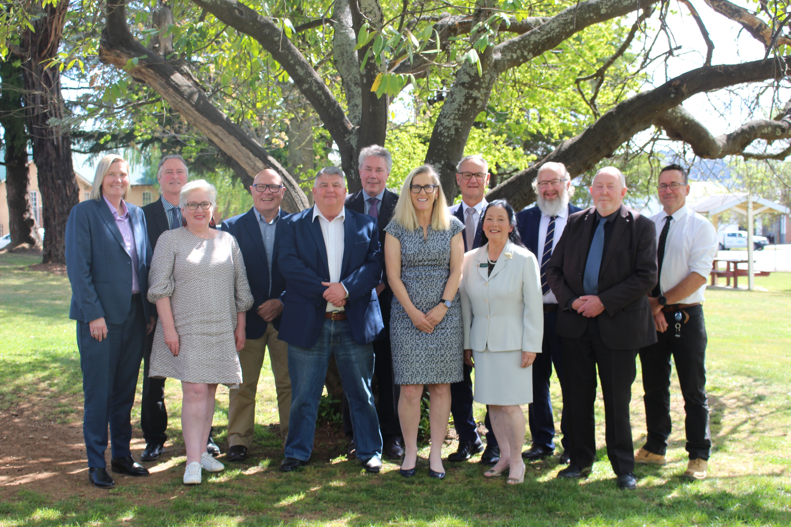

On behalf of ULSC – Thank you for your attendance

